Slide 1
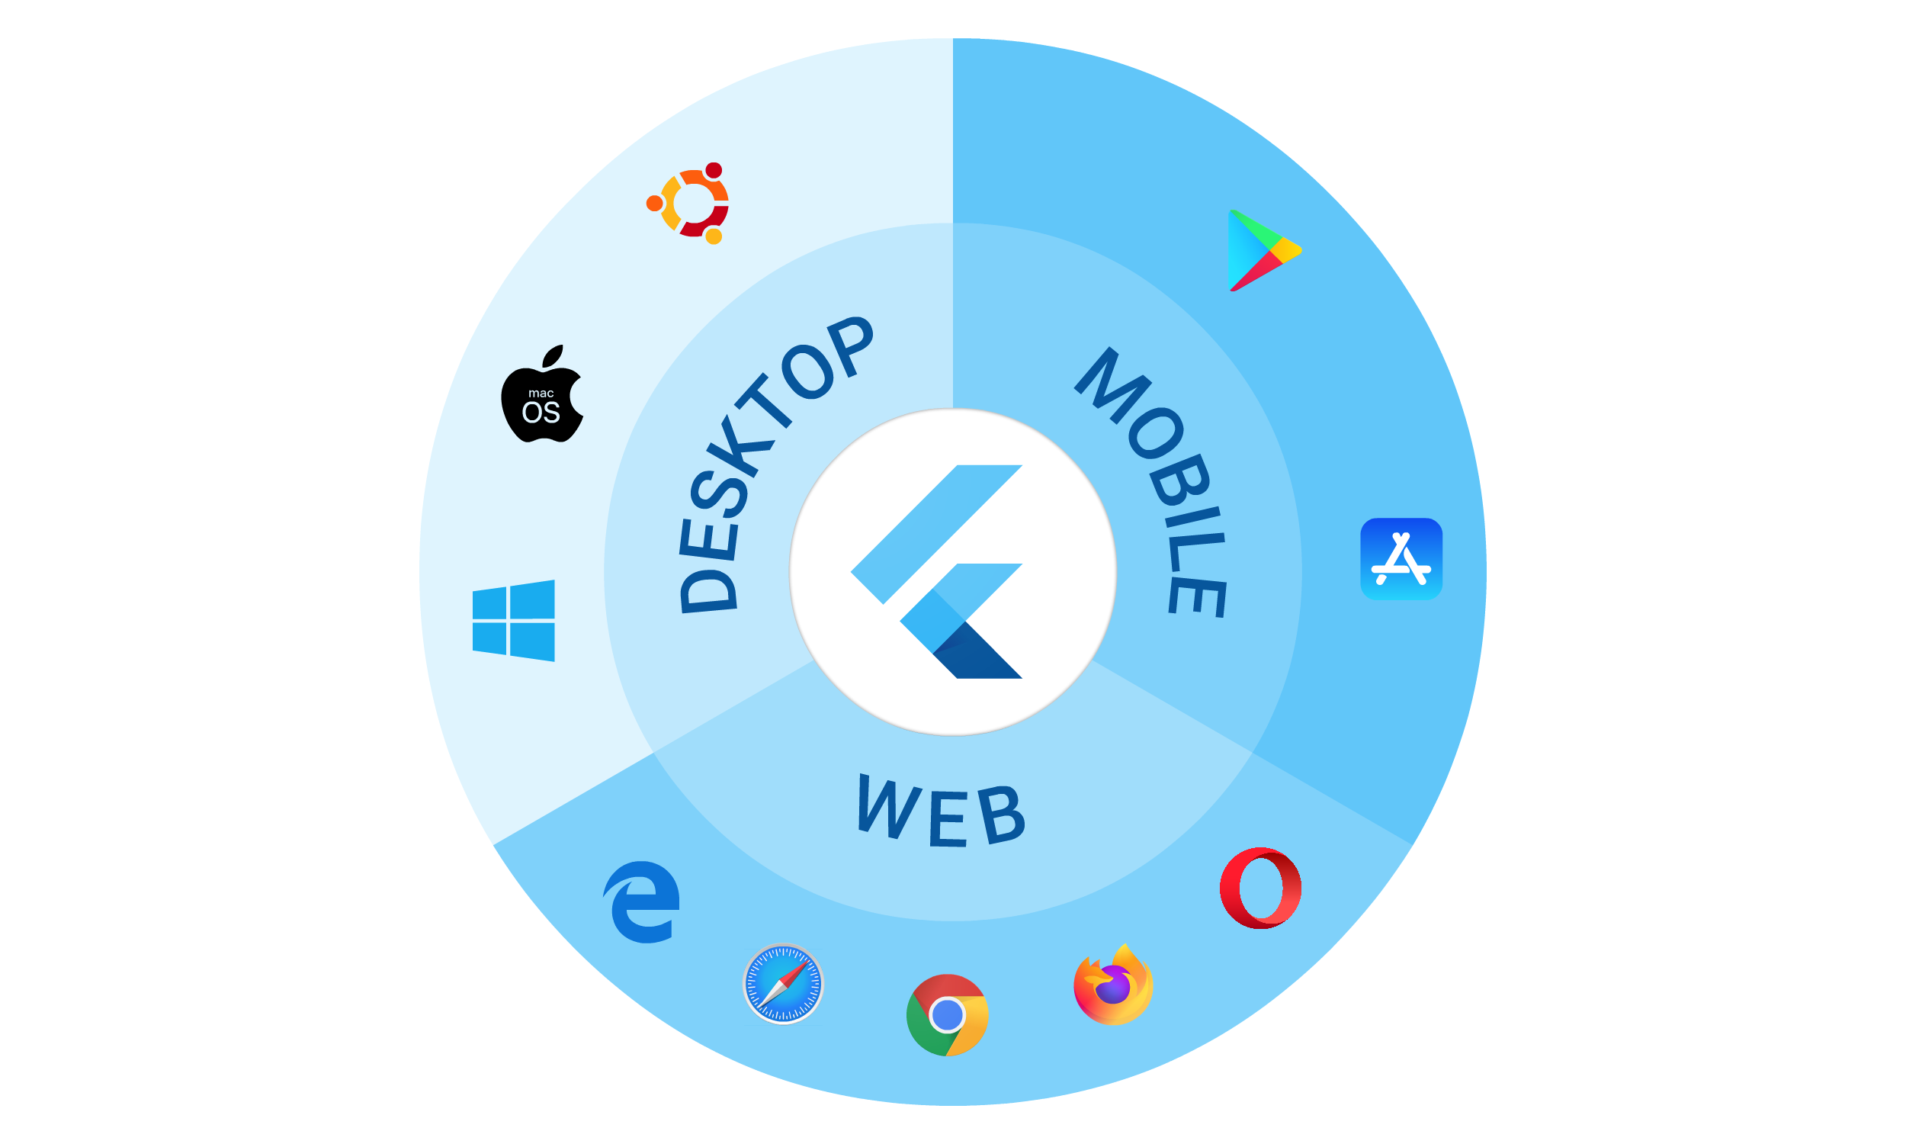
Building truly cross platform apps with Flutter

Slide 2

Flutter for All Platforms ?

Slide 3







Shivam Srivastava
- Mobile Solution Architect at EnrichAI.com - Founder at Navoki.com - Android, Flutter, Dart - Youtuber
Follow Me:
@theshivamlko
youtube.com/navoki
navoki.com

Slide 4


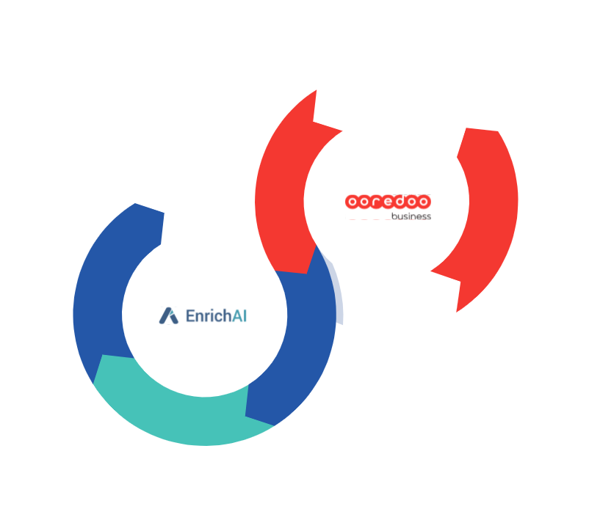


EnrichAI.com

Slide 5






Slide 6
What we will do?
Make Flutter App for Mobile, Web, Desktop
Handle Responsive UI
Demo of Navoki Notes (Flutter + Firebase)

Slide 7
Make Flutter App for Mobile, Web, Desktop

Slide 8




Flutter for Mobile
release.apk
+
+
Runner.app

Slide 9



Flutter for WEB
+

Slide 10
Cont…
Enable WEB in Flutter SDK
flutter config –-enable-web
Run Web App
flutter run –d chrome

Slide 11




Flutter for Desktop
+
myApp.exe
+
Runner.app
+
myApp.snap

Slide 12
Cont…
Enable Desktop in Flutter SDK
flutter config –-enable-<os-name>-desktop
Run Desktop App
flutter run –d <device-name>
Disable Desktop in Flutter SDK
flutter config –-no-enable-<os-name>-desktop

Slide 13
Cont…
Run Flutter App (New Update)
flutter run
Multiple devices found:
Web Server (web) • web-server • web-javascript • Flutter Tools
Chrome (web) • chrome • web-javascript • Google Chrome 84.0.4147.105
[0]: Web Server (web-server)
[1]: Chrome (chrome)
Please choose one: [0|1]:

Slide 14
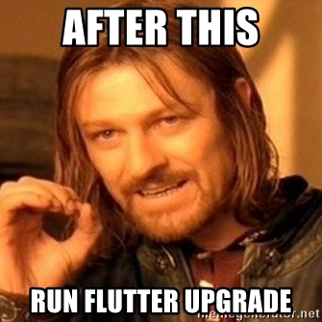
Cont…

Slide 15
Cont…
flutter doctor -v

Slide 16
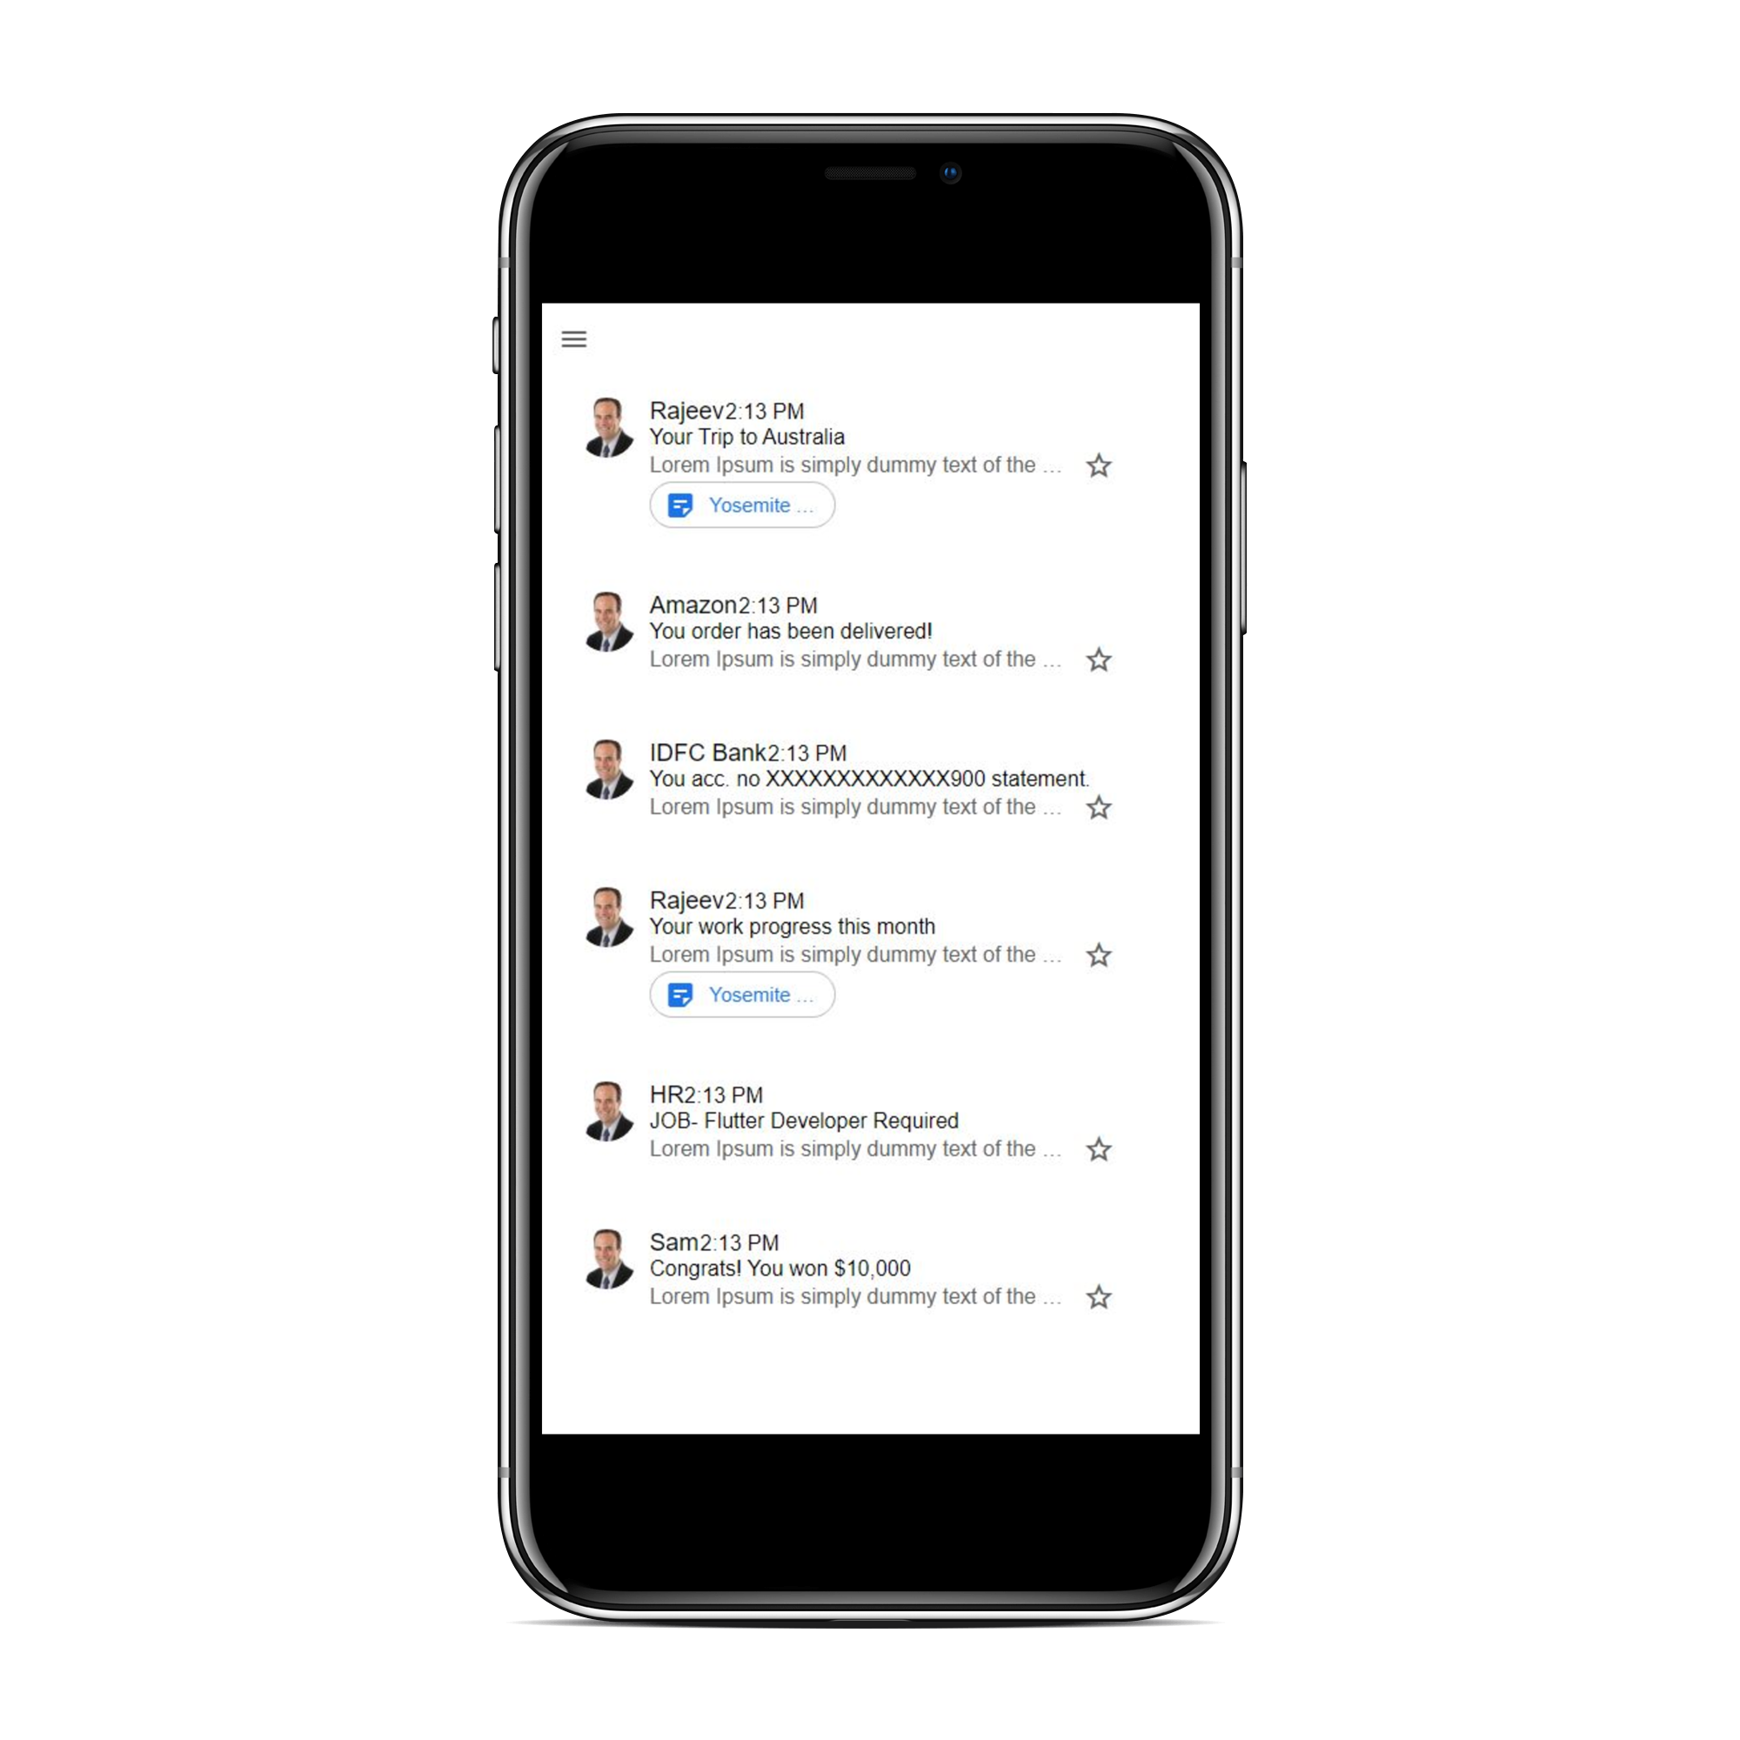
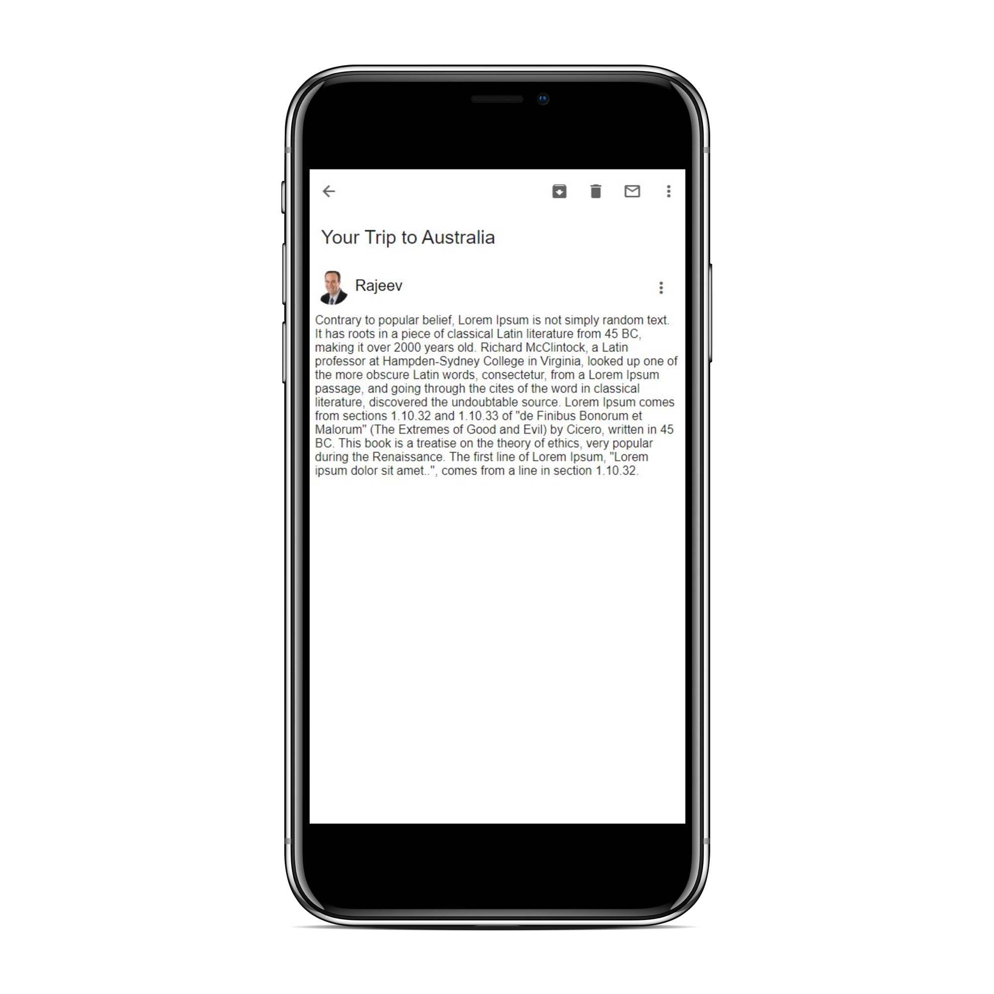
Email App- Mobile
Screen 1
Screen 2

Slide 17
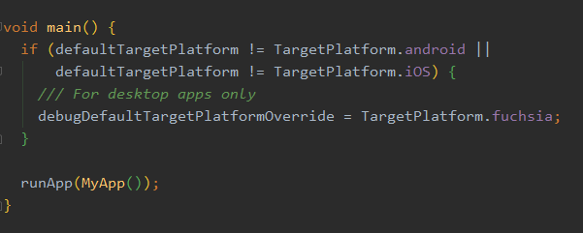
IMPORTANT! Web and Desktop
Assets ,Images, Fonts

Slide 18
Responsive

Slide 19
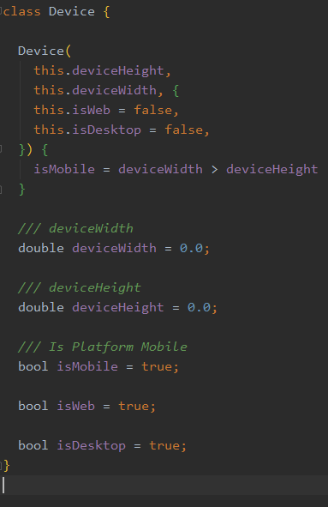
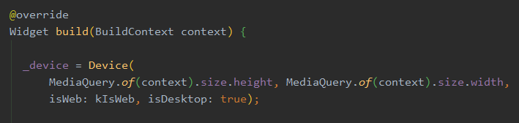
1. Know you platform- Device

Slide 20
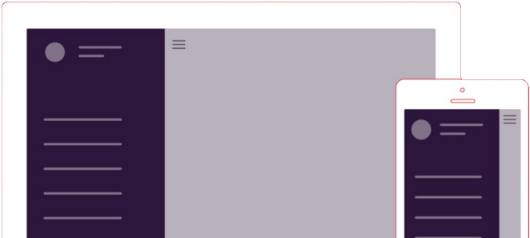
2. Container with MediaQuery
deviceWidth* 0.30
deviceWidth* 0.70

Slide 21
3. Expanded (Row and Column)
flex: 1
flex: 3
flex: 3
flex: 1

Slide 22

4. Wrap Widget

Slide 23
5. Is that all for responsive Widget?
There is more…
https://flutter.dev/docs/development/ui/layout/responsive

Slide 24
Responsive for Web and Desktop ?
Widget 2
Widget 1
Screen 1
Screen 2

Slide 25
Cont...
Widget 1
Widget 2
Screen 1

Slide 26
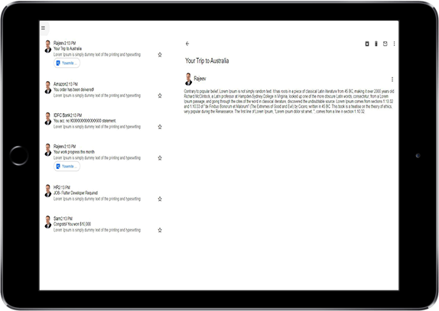
Email App- Web and Desktop
Widget 2
Widget 1
Screen 1

Slide 27
Demo of Navoki Notes (Flutter + Firebase)

Slide 28
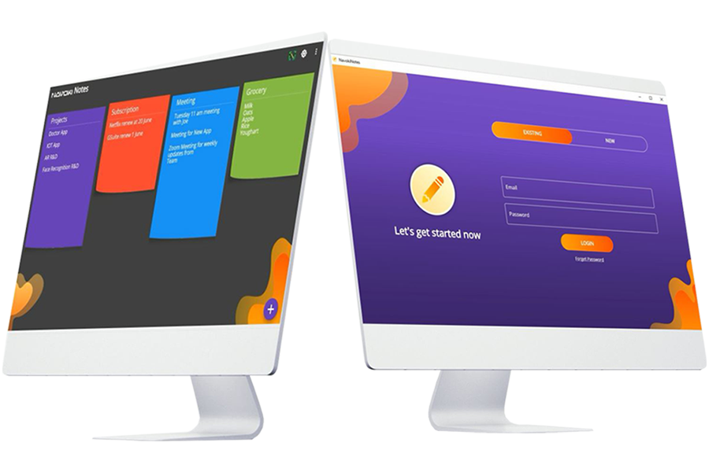
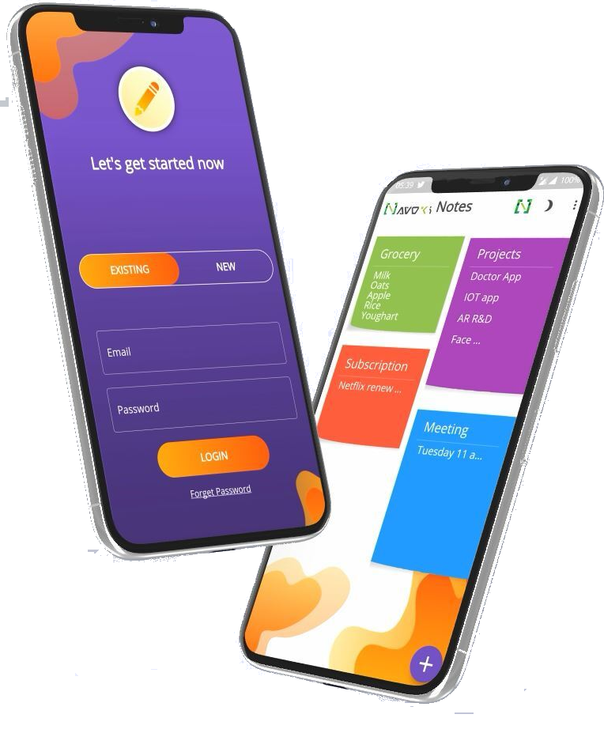
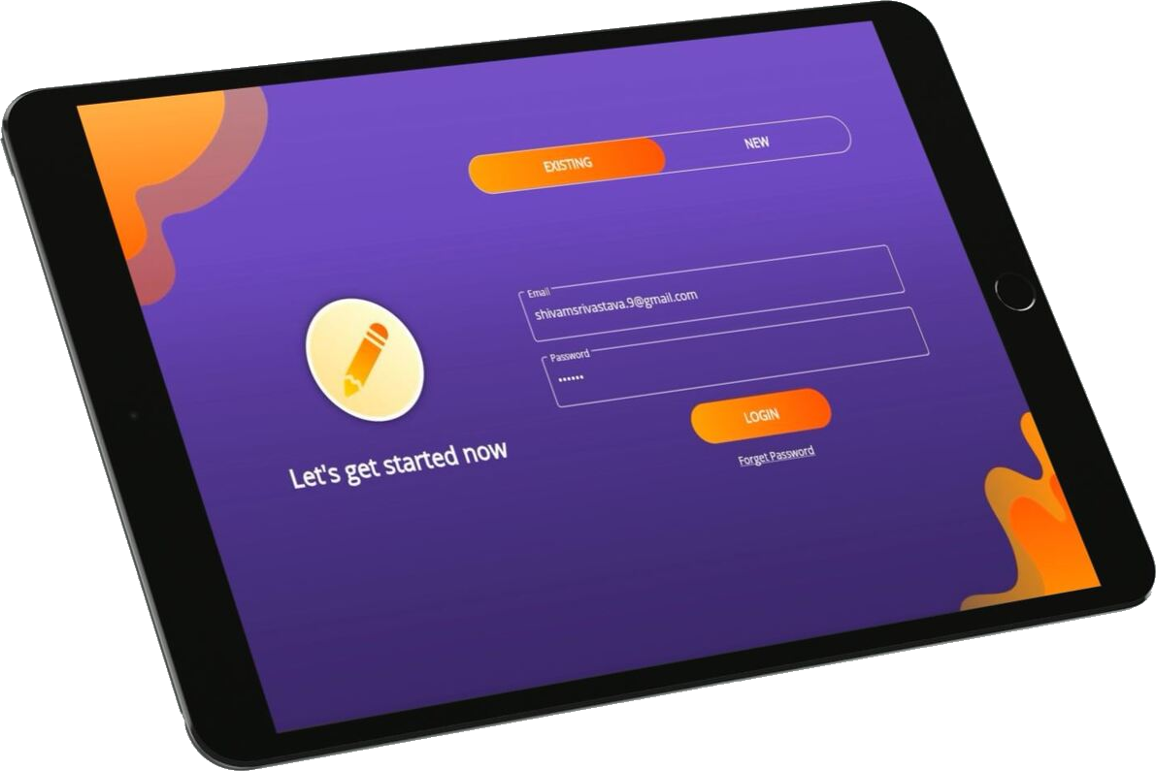
Cross-platform with Flutter - Navoki Notes
Web/PWA
Mobile (Android, iOS)
Desktop (Windows,macOS,Linux)

Slide 29
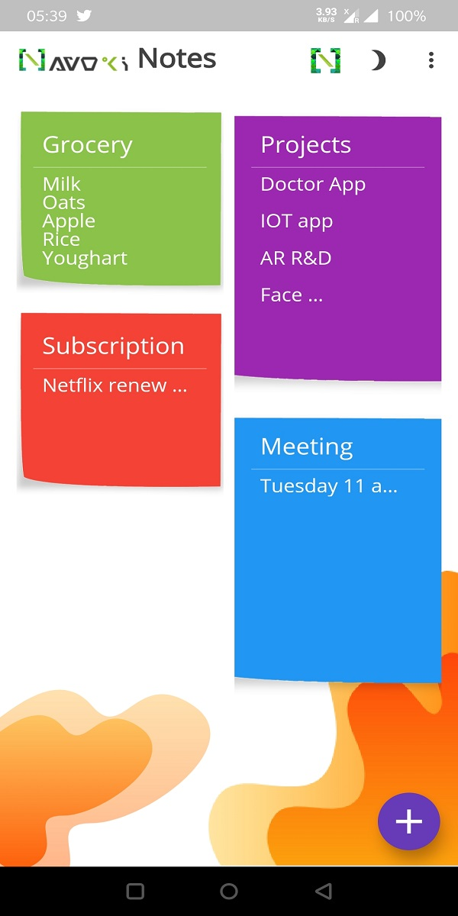
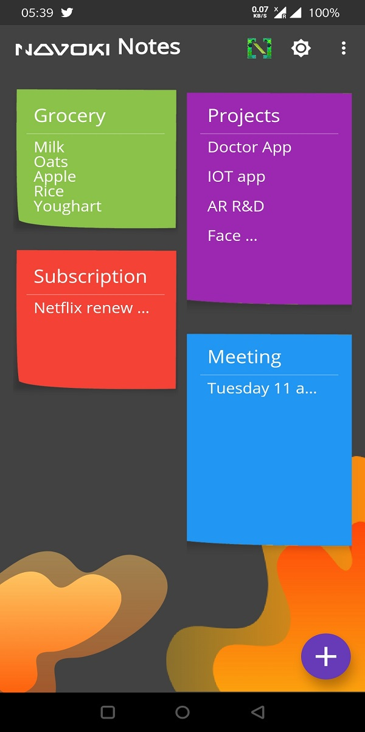
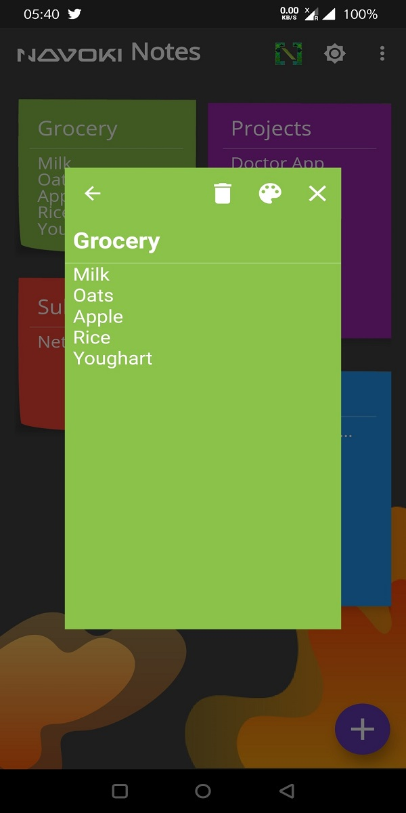
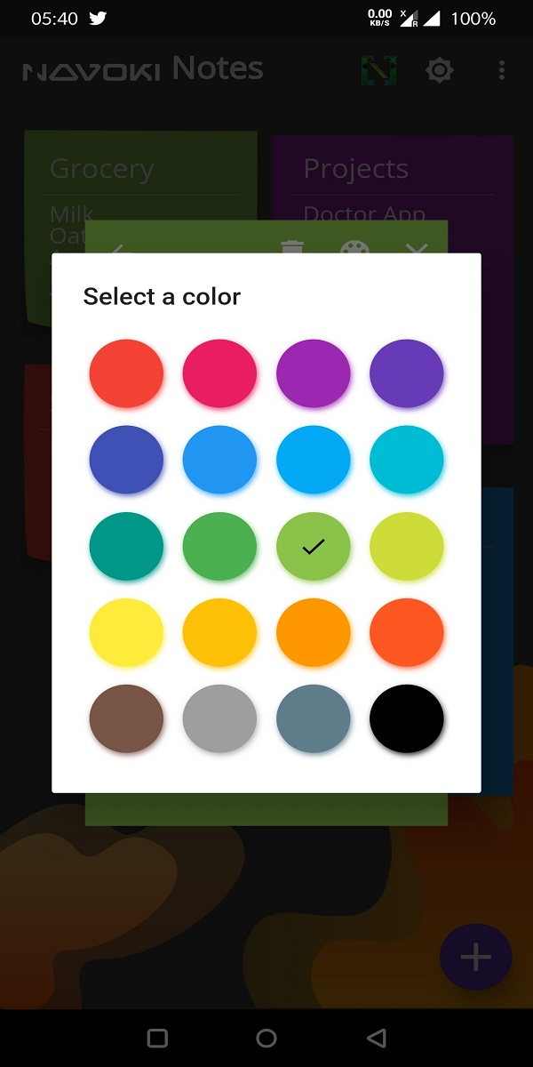
Features
Notes List
Dark Theme
Add Note
Note Color

Slide 30


Backend
+
+
Cloud Firestore
Flutter
Authentication

Slide 31


Open Source - Navoki Notes
Star the Repo
https://github.com/theshivamlko/navoki_notes

Slide 32

The OLDEST Question
Is Flutter ready for Production?

Slide 33
Where to Use?
Business Prototypes
Portfolios
Landing Pages
Admin Panels ( Charts, Reports etc.)
and more…

Slide 34
Production?
Mobile - YES
WEB - Almost
Desktop Windows – NOT YET macOS,Linux- Almost

Slide 35
Tips
File Handling: dart:io not supported in WEB
use dart:html in WEB only
For Desktop: Windows Crashes , Hot Reload Issue
Platform Native Permission Required
Local Storage: cross_local_storage

Slide 36

THANK YOU !

